Slide 1
Skin Recovery Device Training
FOR CADAVERIC USE ONLY

Slide 2
Device Components

Slide 3
Transportation Case
Keep this gray box, it will be used to return the unit after trial or for service.

Slide 4
Complete Amalgatome MD System
Sterilization Tray
Power Supply & Cord
Pin Driver
Hand Piece and Head Assembly
Screw Driver

Slide 5
Power Supply & Cord
Does not go into autoclave.

Slide 6
Sterilization Tray

Slide 7
Sterilization Tray
Ensure the blade locking ring is placed inside the tray with the screw heads facing upward.

Slide 8
Sterilization Tray
Note: as the power cord is wrapped around the outside of the tray, make sure not to apply too much tension at the corners of the tray.

Slide 9
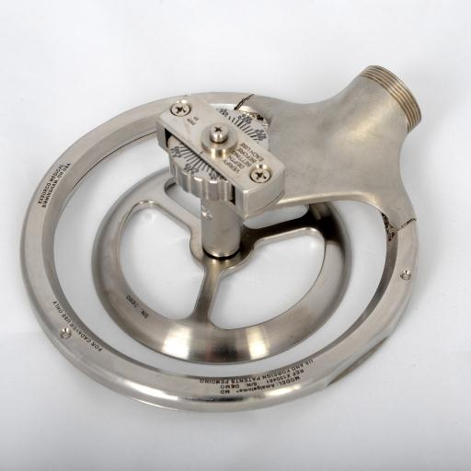
Head Assembly
Depth Adjustment Knob
Housing Frame
The head assembly is not to be disassembled.
Depth Gauge Assembly
Blade Locking Ring w/ 3 Captive Screws
Screw Hole

Slide 10
Hand Piece
Power Cord with Protective Cap
Activation Button
Activation Lever
Locking Knob
Handle
Pinion
Locking Nut

Slide 11
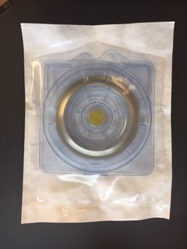
Disposable Blades
Note: Always check the sterile blade package integrity and expiration dates before use.
Sterile, Single Use

Slide 12
Disposable Blades
Please note: this is best practice for handling the blade.

Slide 13
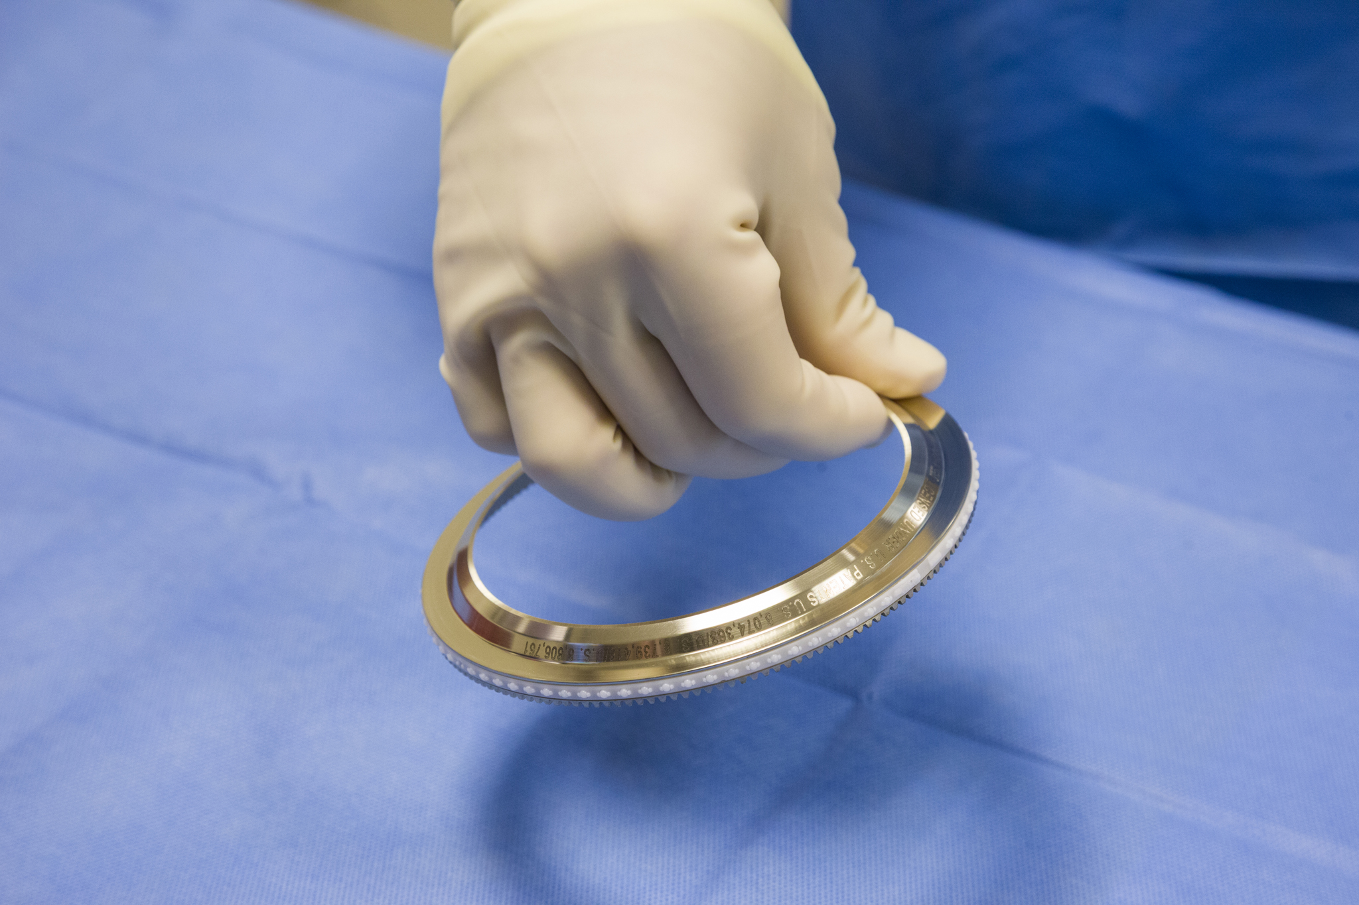
Disposable Blades
Please note: it is not safe to handle the blade anywhere on the inside of the blade as shown here.

Slide 14
Operator & Circulator
Operator
Circulator
When the term "sterile operator" is used this refers to the technician who has followed protocols for scrubbing, gowning and gloving and is practicing sterile technique.
When the term "circulator" is used this refers to the technician who is not scrubbed in and is providing support within the recovery room.

Slide 15
Need to get a hold of us?
Phone: 1-800-243-6049
Press the number below for the following departments:
1 – Sales & Clinical Support
2 – Marketing & Product Inquiries
4 – Customer Service or to Report a Quality Concern
5 – Technical Services
6 – Quality Department
7 – Accounting Department
Website: www.exsurco.com
Emails:
Sales: sales@exsurco.com
Information: info@exsurco.com
Support: support@exsurco.com

